Slide 1

Advanced Machine Learning Project

Slide 2

Group Members:
Ramanpreet Kaur
Gracy Jason Joseph
Saiyudh Mannan
Azima Islam Fariha
Shweta Pandey
Group 15

Slide 3
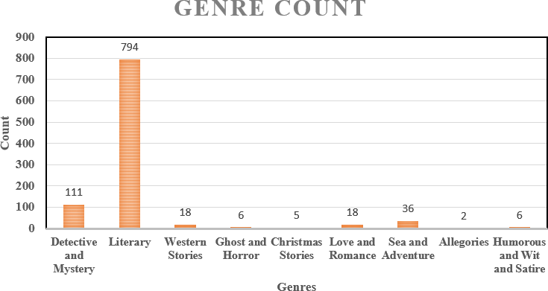
MOTIVATION & PROBLEM STATEMENT
‘Supervised Genre identification’ is a problem
Our goal is to extract the features which are relevant to fiction books
To investigate which supervised machine learning methods are best suited to solve it

Slide 4
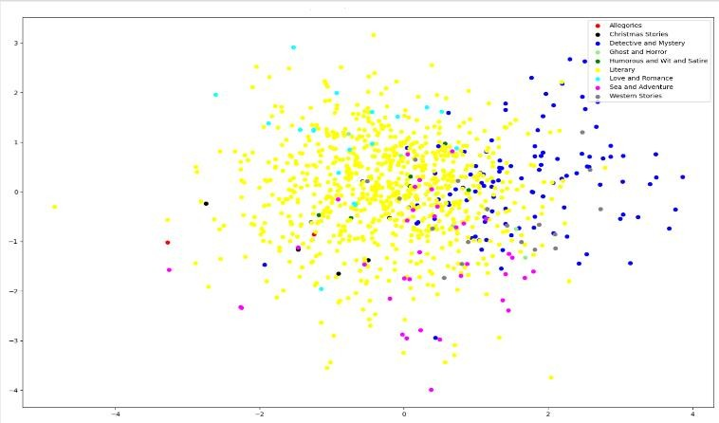
Porblems we came across with the dataset:
While data exploration, from these 996 books we found that two books are empty and one book has barely 30 words
Each book is an html file and ‘BeautifulSoup’ library is used to read the HTML data
There were imbalance classes.
Scatter plot has been provided to show the dataset imbalance.

Slide 5
CONCEPT
Data Transformation:
LDA Topic generation
WORDCLOUD exploratory analysis
FASTTEXT (method) with PCA

Slide 6
CONCEPT
Word2Vec
TFIDF-Term frequency-inverse document frequency

Slide 7
Features relevant to Fictions books
TEXT | FEATURES
Reading ease | Flesch Reading ease Smog Reading ease
Lexical Complexity | Lexical Diversity: No. of unique tokens/ No. of tokens Lexical Density: Noun Ratio Verb Ratio Adverb Ratio Adjective Ratio
Writing Style | Personal Pronoun Possessive Pronoun Preposition Colon Hyphen Interjection Punctuation Conjunction

Slide 8
Features relevant to Fictions books
TEXT | FEATURES
Country side/ Urban setting | Number of Quotes Number of Characters
High Level Ratio | Adverb Adjective Ratio Adjective Noun Ratio Adjective Pronoun Ratio
Sentiment | Subjectivity Polarity
Sentence Level Complexity | Average Sentence Length Sentence Complexity
Additional | Word Count Punctuation Ratio Average Syllable count

Slide 9
METHODS
We have performed model selection for the below three methods:
Linear Support Vector Machine
Multinomial Naive Bayes classifier
Logistic regression

Slide 10
IMPLEMENTATION
Data Preprocessing
All html files are read into text using BeautifulSoup Library and later combined into one file along with its Genre information, author name, book name using book_id.
Feature Extraction
Since our features are relevant to fictions, stop words removal and words stemming is avoided, as every word and token carries information , rather all the words, punctuations, etc. are taken into consideration to generate various level features.
Total 25 features are extracted at the document level

Slide 11
Detailed explanation how each feature is generated
TEXT | FEATURES
Reading ease | We used two formulas namely FRE (Flesch Reading Ease) and SMOG Grading. FRE= 206.835-(1.015* Average Sentence Length) – (84.6 * average word length in syllable) SMOG= 3+ (Polysyllable Count)^(1/2)
Lexical Complexity | Lexical Diversity: No. of unique tokens/ No. of tokens Lexical Density: For this part, POS tagging was used to count occurrence of each and later normalized to number of words in a document.
Writing Style | (Ratio of personal pronouns, Possessive pronouns preposition , colons and Hyphens, Interjection and punctuation Subordination Conjunction) Calculated using POS tagging and using Counter from Collections library
COUNTRY SIDE/ URBAN SETTING | No. of quotes and Total no. of characters in each book is explored – using POS tagging For No. of characters, Proper nouns are counted once.

Slide 12
Features relevant to Fictions books
TEXT | FEATURES
HIGH LEVEL RATIO | Different ratio are calculated as- Adverb Adjective ratio Adjective Noun ratio Adjective pronoun ratio
SENTENCE LEVEL COMPLEXITY | Average sentence length in document is explored using number of sentences divided by total number of words in a document Complexity can be calculated using usage of clauses in a sentences
SENTIMENT | Library Textblob is used to get sentiment analysis Polarity is a is a floating-point number that lies in the range of [-1,1] where 1 means positive and -1 means negative. Subjectivity is refers to how some one’s is shaped by personal opinions and feelings Subjectivity is represented as a floating-point value which lies in the range of [0,1].

Slide 13
ADDITIONAL FEATURES
Feature Selection
Individual Features scores and importance is calculated using Sklearn library, such as chi square method and feature importance using tree based classifiers.
Fig: Feature importance on Original dataset Fig: Feature importance on Balanced dataset

Slide 14
Balancing Dataset
- We used Imblearn Library for balancing dataset using oversampling technique.
- SMOTE and BorderlineSMOTE are explored
Fig: Oversampling using SMOTE
Fig: Oversampling using BorderLineSMOTE

Slide 15
EVALUATION
Model Selection
- Linear SVM was the method which was preferred on the basis of metric score, f1_weighted
It performed similar way in balanced dataset (SMOTE) and also in the original dataset.
Grid Search
Used for tuning of hyper parameters
Best combinations were C: [100], kernel: [‘linear’] and gamma: [0.001]
Fig: Model selection – Original dataset
Fig: Balanced Dataset

Slide 16
EVALUATION
Cross Validation
- For training we have used the cross fold=5.
- With that the micro_f1 score that takes care of balanced dataset was 0.90 and that of the original dataset was 0.71.
20% of the dataset is used for testing and for cross validation, 80% with the 5 folds.
Evaluating Measures
- We decided to use the evaluating measures like Micro-f1, confusion matrix to compare our model
- It is recognized that classifiers work well when each class is fairly represented in the training data.
- For a dataset with 99% negative events and 1% positive events, a model could be 99% accurate, predicting all instances as negative, though, being useless.

Slide 17
Micro-F1:
We had to compute micro-averaged precision and micro-averaged recall over all the samples and then combine the two
Confusion Matrix:
The score that is responsible for Balanced dataset is 0.90 and that of the original dataset is 0.71.

Slide 18

THANK YOU SO MUCH!

